Slide 1
Lecture 9
Conditional Statements
CSCI – 1900 Mathematics for Computer Science
Fall 2014
Bill Pine

Slide 2
Lecture Introduction
Reading
  Rosen - Sections 1.1, 1.2, 1.4
Additional logical operations
  Implication
  Equivalence
Conditions
  Tautology
  Contingency
  Contradiction / Absurdity

Slide 3
Conditional Statement/Implication
"if p then q"
Denoted p ⇒ q
  p is called the antecedent or hypothesis
  q is called the consequent or conclusion
Example:
  p: I am hungry
  q: I will eat
  p: It is snowing
  q: 3+5 = 8

Slide 4
Conditional Statement (cont)
In conversational English, we would assume a cause-and-effect relationship, i.e., the fact that p is true would force q to be true
If “it is snowing,” then “3+5=8” is meaningless in this regard since p has no effect at all on q
For now, view the operator “⇒” as a logic operation similar to conjunction or disjunction (AND or OR)

Slide 5
Truth Table Representing Implication
If viewed as a logic operation, p ⇒ q can only be evaluated as false if p is true and q is false
Again, this does not say that p causes q
Truth table
p | q | p ⇒ q
T | T | T
T | F | F
F | T | T
F | F | T

Slide 6
Implication Examples
If p is false, then any q supports p ⇒ q is true
  False ⇒ True = True
  False ⇒ False = True
If “2+2=5” then “I am the king of England” is true

Slide 7
Truth Table Representing Implication
If viewed as a logic operation, p ⇒ q is the same as
~p ∨ q,
  If p is true and q is false, the implication is false; otherwise the implication is true
Truth table
p | q | ~p | ~p ∨ q | p ⇒ q
T | T | F | T | T
T | F | F | F | F
F | T | T | T | T
F | F | T | T | T

Slide 8
Converse and Contrapositive
The converse of the implication p ⇒ q is the implication q ⇒ p
The contrapositive of implication p ⇒ q is the implication ~q ⇒ ~p

Slide 9
Example
Example: What is the converse and contrapositive of p: "it is raining" and q: I get wet?
  Implication: If it is raining, then I get wet.
  Converse: If I get wet, then it is raining.
  Contrapositive: If I do not get wet, then it is not raining.

Slide 10
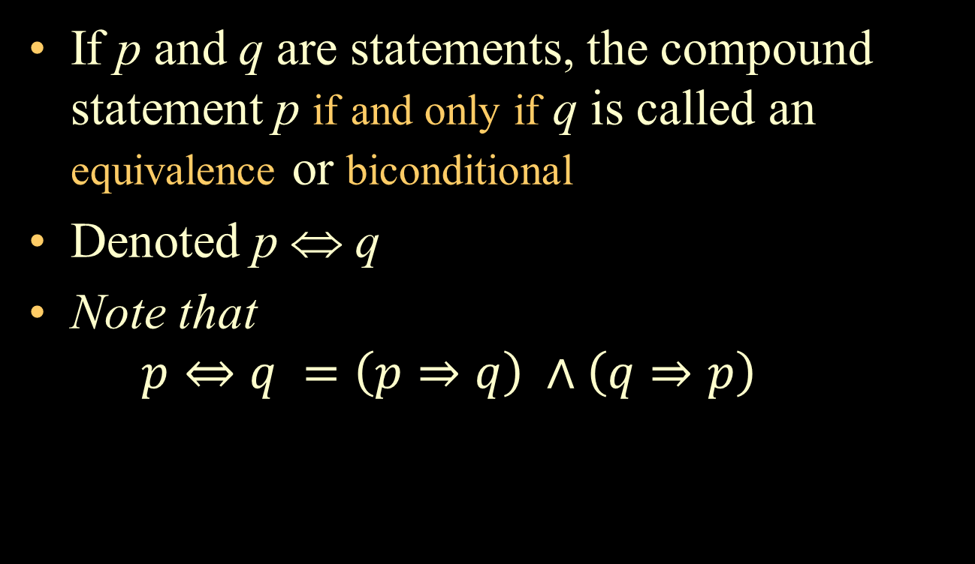
Equivalence or Biconditional
If p and q are statements, the compound statement p if and only if q is called an equivalence or biconditional
Denoted p ⇔ q
Note that
$p⇔q =\left(p⇒q\right) ∧\left(q⇒p\right)$

Slide 11
Equivalence Truth Table
The only time an equivalence evaluates as true is if both statements, p and q, are true or both are false
p | q | p⇔q
T | T | T
T | F | F
F | T | F
F | F | T

Slide 12
Properties
Commutative Properties
  p ∨ q = q ∨ p
  p ∧ q = q ∧ p
Associative Properties
  (a ∨ b) ∨ c = a ∨ (b ∨ c)
  (a ∧ b) ∧ c = a ∧ (b ∧ c)

Slide 13
Properties
Distributive Properties (prove by Truth Tables)
  a ∧ (b ∨ c) = (a ∧ b) ∨ (a ∧ c)
  a ∨ (b ∧ c) = (a ∨ b) ∧ (a ∨ c)
Idempotent properties
  a ∨ a =a
  a ∧ a =a

Slide 14
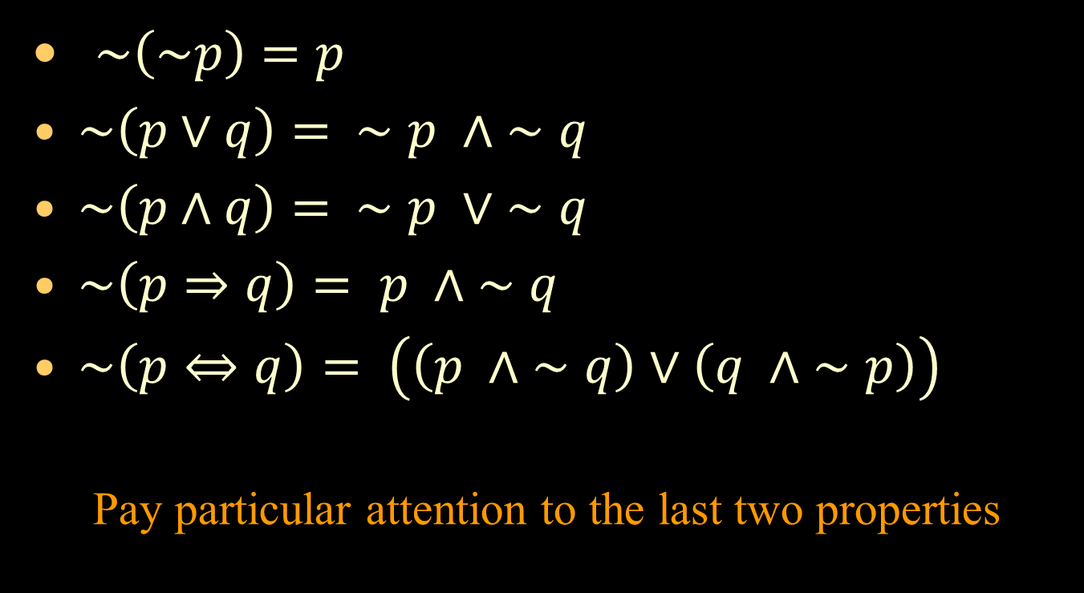
Negation Properties
$\sim \left(\sim p\right)=p$
$\sim \left(p∨q\right)= ∼p ∧ ∼q$
$\sim \left(p∧q\right)= ∼p ∨ ∼q$
$\sim \left(p⇒q\right)= p ∧ ∼q$
$\sim \left(p⇔q\right)= \left(\left(p ∧ ∼q\right)∨\left(q ∧ ∼p\right)\right)$
  Pay particular attention to the last two properties
}
De Morgan’s Laws

Slide 15
Proof of the Contrapositive
Compute the truth table of the statement
(p ⇒ q) ⇔ (~q ⇒ ~p)
p | q | p ⇒ q | ~q | ~p | ~q ⇒ ~p | (p ⇒ q) ⇔ (~q ⇒ ~p)
T | T | T | F | F | T | T
T | F | F | T | F | F | T
F | T | T | F | T | T | T
F | F | T | T | T | T | T

Slide 16
Tautology and Contradiction
A statement that is true for all values of its propositional variables is called a tautology
  The previous truth table was a tautology
A statement that is false for all values of its propositional variables is called a contradiction or an absurdity

Slide 17
Contingency
A statement that can be either true or false depending on the values of its propositional variables is called a contingency
Examples
  (p ⇒ q) ⇔ (~q ⇒ ~p) is a tautology
  p ∧ ~p is an absurdity
  (p ⇒ q) ∧ ~p is a contingency since some cases evaluate to true and some to false

Slide 18
Contingency Example
The statement (p ⇒ q) ∧ (p ∨ q) is a contingency
p | q | p ⇒ q | p ∨ q | (p ⇒ q) ∧ (p ∨ q)
T | T | T | T | T
T | F | F | T | F
F | T | T | T | T
F | F | T | F | F

Slide 19
Logically Equivalent
Two propositions are logically equivalent or simply equivalent if p ⇔ q is a tautology
Denoted p ≡ q

Slide 20
Example of Logical Equivalence
Columns 5 and 8 are equivalent
p | q | r | q ∧ r | p ∨ (q∧r) | p ∨ q | p ∨ r | (p ∨ q) ∧ ( p ∨ r) | p ∨ (q ∧ r) ⇔ ( p ∨ q) ∧ ( p ∨ r)
T | T | T | T | T | T | T | T | T
T | T | F | F | T | T | T | T | T
T | F | T | F | T | T | T | T | T
T | F | F | F | T | T | T | T | T
F | T | T | T | T | T | T | T | T
F | T | F | F | F | T | F | F | T
F | F | T | F | F | F | T | F | T
F | F | F | F | F | F | F | F | T

Slide 21
Key Concepts Summary
Additional logical operations
  Implication
  Equivalence
Conditions
  Tautology
  Contingency
  Contradiction / Absurdity

